Slide 1
Battery Recycling
2nd Grade Earth Day Project
April, 2011

Slide 2
This year 2nd Grade learned about the dangers of putting batteries into landfills.

Slide 3
We learned that:
  Americans throw away 2.9 BILLION batteries each year!
  Batteries have dangerous chemicals inside.
  The large machines used in landfills break batteries open and the chemicals leak out into the groundwater.
  The mercury in one watch battery can contaminate 6 tons of trash!

Slide 4
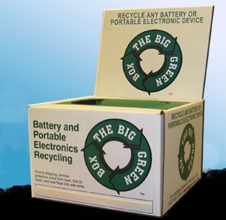
We decided to collect used batteries and send them to The Big Green Box, a company that recycles batteries and electronics.
We started our collections in January and continued throughout February and March.

Slide 5
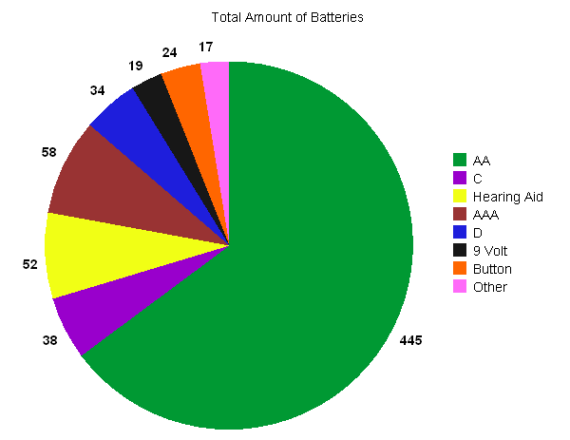
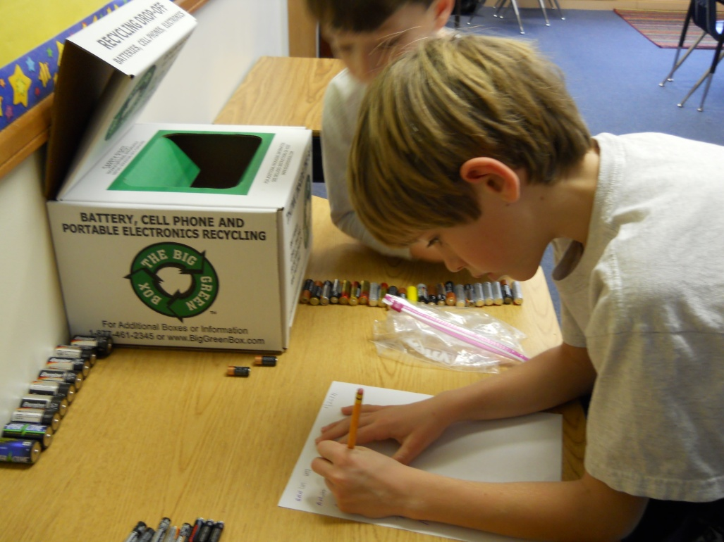
Here are the different types of batteries we collected and the total numbers for each type:

Slide 6
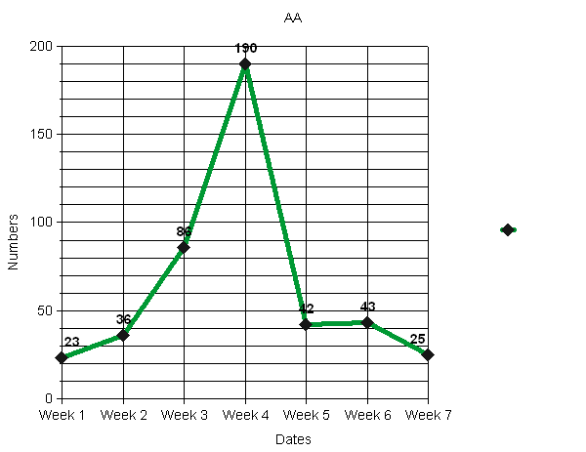
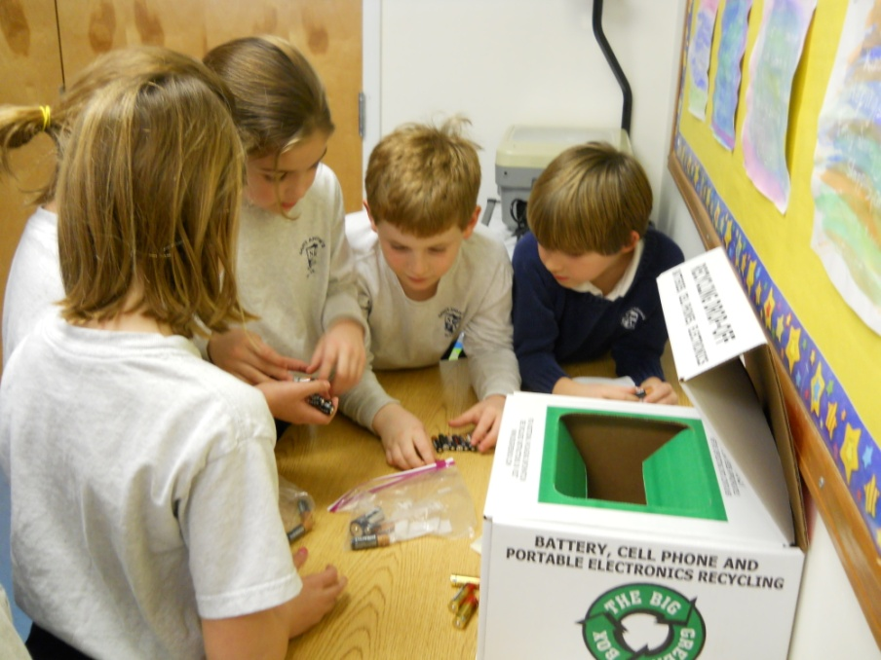
AA

Slide 7
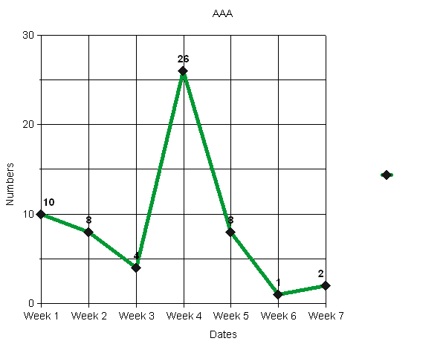
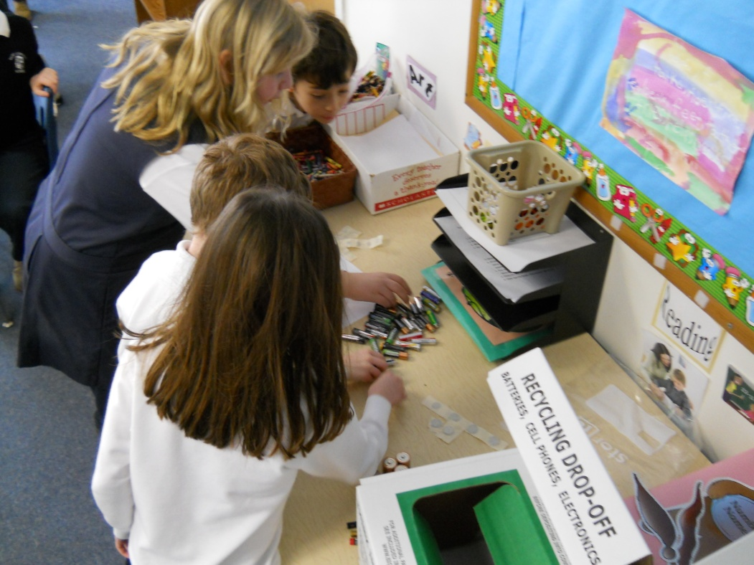
AAA

Slide 8
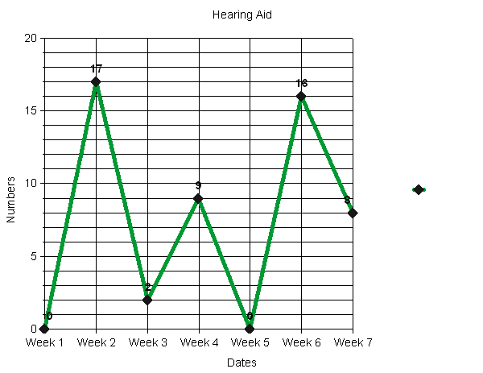
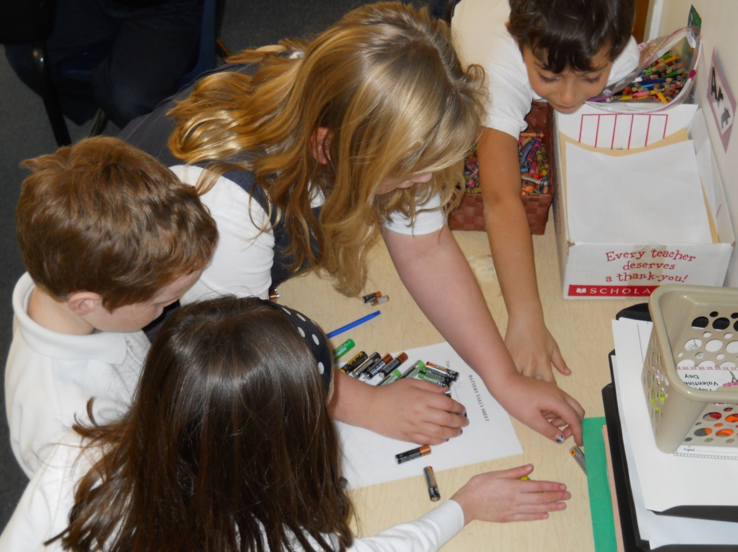
Hearing Aid

Slide 9
Thank you for brining your batteries to us to help with our Earth Day project.
You can continue helping the Earth by taking your used batteries to Best Buy to be recycled.

